Slide 1

Incident Management
CHAPTER 40

Slide 2
National EMS Education Standard Competencies (1 of 3)
EMS Operations
Knowledge of operational roles and responsibilities to ensure patient, public, and personnel safety.
Incident Management
Establish and work within the incident management system.
Notes:
National EMS Education Standard Competencies
EMS Operations
Knowledge of operational roles and responsibilities to ensure patient, public, and personnel safety.
Incident Management
• Establish and work within the incident management system.

Slide 3
National EMS Education Standard Competencies (2 of 3)
Multiple-Casualty Incidents
Triage principles
Resource management
Triage
  Performing
  Retriage
  Destination decisions
  Posttraumatic and cumulative stress
Notes:
National EMS Education Standard Competencies
Multiple-Casualty Incidents
• Triage principles
• Resource management
• Triage
• Performing
• Retriage
• Destination decisions
• Posttraumatic and cumulative stress

Slide 4
National EMS Education Standard Competencies (3 of 3)
Hazardous Materials Awareness
Risks and responsibilities of operating in a cold zone at a hazardous material or other special incident.
Notes:
National EMS Education Standard Competencies
Hazardous Materials Awareness
• Risks and responsibilities of operating in a cold zone at a hazardous material or other special incident.

Slide 5
Introduction (1 of 2)
Disasters and mass-casualty incidents (MCIs) can be overwhelming.
  Three or more patients
  Lack of resources
Incident command system (ICS)
  Makes it possible to do the greatest good for the greatest number
Notes:
Lecture Outline
A. The most challenging situations you can be called to are disasters and mass-casualty incidents (MCIs).
1. A mass-casualty incident refers to any call that involves three or more patients, or any situation that places such a great demand on available equipment or personnel that the system would require a mutual aid response.
a. An agreement between neighboring EMS systems to respond when local resources are insufficient to handle the response
B. These incidents can be overwhelming, because you will find a large number of patients and not enough resources.
C. Use of the incident command system (ICS) makes it possible to do the greatest good for the greatest number of people.
D. As an EMT, you will typically be assigned to work within the EMS/medical branch under an ICS.

Slide 6
Introduction (2 of 2)
National Incident Management System (NIMS)
  Promotes efficient coordination of emergency incidents at the regional, state, and national levels
Notes:
Lecture Outline
E. The National Incident Management System (NIMS) was developed to promote efficient coordination of emergency incidents at the regional, state, and national levels.

Slide 7
National Incident Management System (1 of 3)
Implemented in 2004
Provides a framework to enable federal, state, and local governments to work together
  Includes private-sector and nongovernmental organizations
Notes:
Lecture Outline
II. National Incident Management System
A. The Secretary of Homeland Security implemented the NIMS in 2004.
1. It provides a framework to enable federal, state, and local governments, as well as private-sector and nongovernmental organizations, to work together effectively.

Slide 8
National Incident Management System (2 of 3)
Organizational structure must be flexible enough to be rapidly adaptable.
Provides standardization in:
  Terminology
  Resource classification
  Personnel training
  Certification
Notes:
Lecture Outline
2. The organizational structure must be flexible enough to be rapidly adapted for use in any situation.
3. The NIMS provides standardization in:
a. Terminology
b. Resource classification
c. Personnel training
d. Certification
4. Another important feature is the concept of interoperability, which refers to the ability of agencies of different types or from different jurisdictions to communicate with each other.

Slide 9
National Incident Management System (3 of 3)
Major NIMS components
  Communications and information management
  Resource management
  Command and management
Notes:
Lecture Outline
B. The ICS is one component of the NIMS.
1. The major NIMS components are as follows:
a. Communications and information management
b. Resource management
c. Command and management
2. The standard incident command structures are based on three key constructs:
a. ICS
b. Multiagency coordination systems, and public information systems.

Slide 10
Incident Command System (1 of 8)
Sometimes referred to as the incident management system
The purpose of the ICS is:
  Ensure responder and public safety
  Achieve incident management goals
  Ensure the efficient use of resources
Notes:
Lecture Outline
III. Incident Command System
A. The ICS is sometimes referred to as the incident management system.
B. The purpose of the ICS is:
1. Ensure responder and public safety
2. Achieve incident management goals
3. Ensure the efficient use of resources
C. Communication is the building block of good patient care.
1. Common terminology and the use of “clear text” communications help responders from multiple agencies work efficiently together.

Slide 11
Incident Command System (2 of 8)
Controls duplication of effort and freelancing
Limits the span of control
  One supervisor for three to seven workers
Organizational levels include sections, branches, divisions, and groups.
Notes:
Lecture Outline
D. The goal of the ICS is to make the best use of your resources to manage the environment around the incident and to treat patients during an emergency.
1. The ICS is designed to control duplication of effort and freelancing.
2. One of the organizing principles of the ICS is limiting the span of control of any one individual.
3. Organizational levels may include sections, branches, divisions, and groups.

Slide 12
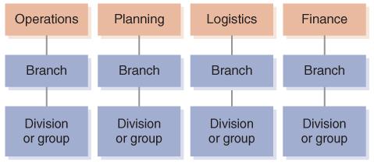
Incident Command System (3 of 8)
FIGURE 40-1 The ICS organizational structure may include sections, branches, divisions, and groups.
© Jones & Bartlett Learning.
Notes:
The figure on this slide illustrates the ICS organizational structure.

Slide 13
Incident Command System (4 of 8)
Roles and responsibilities
  Command
  Finance
  Logistics
  Operations
  Planning
  Command staff
Notes:
Lecture Outline
E. The ICS roles and responsibilities
1. The general staff includes command, finance, logistics, operations, and planning.
2. Command staff includes the public information officer (PIO), safety officer, and liaison officer.

Slide 14
Incident Command System (5 of 8)
Command
  Incident commander (IC) is in charge of the overall incident.
  It is important to know who the IC is, how to communicate with the IC, and where the command post is located.
  An IC may turn over command to someone with more experience in a critical area.
Notes:
Lecture Outline
3. Command
a. The incident commander (IC) is in charge of the overall incident.
b. Large incidents require a multiagency or multijurisdiction response and need to use a unified command system.
c. A single command system is one in which one person is in charge, even if multiple agencies respond.
d. It is important that EMTs know who the IC is, how to communicate with the IC, and where the command post is located.
i. If the incident is very large, EMTs will report to a supervisor working under the IC.
e. An IC may turn over command to someone with more experience in a critical area.
f. When an incident draws to a close, there should be a termination of command.
i. An agency should have demobilization procedures to implement as the situation deescalates or comes to an end.

Slide 15
Incident Command System (6 of 8)
Finance
  Responsible for documenting all expenditures at an incident for reimbursement
Logistics
  Responsible for communications equipment, facilities, food and water, fuel, lighting, and medical equipment/supplies
Notes:
Lecture Outline
4. Finance
a. Responsible for documenting all expenditures at an incident for reimbursement
b. Various functions within the finance section:
i. Time unit
ii. Procurement unit
iii. Compensation/claims unit
iv. Cost unit
5. Logistics
a. The logistics section or section chief has responsibility for:
i. Communications equipment
ii. Facilities
iii. Food and water
iv. Fuel
v. Lighting
vi. Medical equipment and supplies for patients and emergency responders

Slide 16
Incident Command System (7 of 8)
Operations
  At a very large or complex incident, responsible for managing the tactical operations usually handled by the IC
  Supervises the people working at the scene
Planning
  Solves problems as they arise
  Develops an incident action plan
Notes:
Lecture Outline
6. Operations
a. At a very large or complex incident, the operations section is responsible for managing the tactical operations usually handled by the IC.
b. The operation section chief will supervise the people working at the scene of an incident, who will be assigned to branches, divisions, and groups.
7. Planning
a. This section solves problems as they arise.
i. Obtains data about the problem
ii. Analyzes the previous incident plan
iii. Predicts what or who is needed to make the new plan work
iv. Works closely with the operations, finance, and logistics sections
b. Another function is to develop an incident action plan, which is the central tool for planning during a response to a disaster emergency.
i. Provides clear, concise information about incident activities, including objectives, tactics, and assignments.

Slide 17
Incident Command System (8 of 8)
Command staff
  The safety officer monitors the scene for conditions or operations that may present a hazard.
  The public information officer (PIO) provides the media with clear and understandable information.
  The liaison officer relays information and concerns among command, the general staff, and other agencies.
Notes:
Lecture Outline
8. Command staff
a. The safety officer monitors the scene for conditions or operations that may present a hazard to responders and patients.
i. He or she has the authority to stop an emergency operation whenever a rescuer is in danger.
ii. A safety officer should remove hazards to EMS personnel and patients before the hazards cause injury.
b. The public information officer (PIO) provides the public and media with clear and understandable information.
i. The PIO must keep the media safe and from becoming part of the incident.
ii. May cooperate with PIOs from other agencies in a joint information center (JIC).
c. The liaison officer relays information and concerns among command, the general staff, and other agencies.

Slide 18
Communications and Information Management
Communication has historically been the weak point at most major incidents.
It is recommended that communications be integrated.
  All agencies should be able to communicate quickly and effortlessly via radios.
  Communications allow for accountability and instant communication.
Notes:
Lecture Outline
F. Communications and information management
1. Communication has historically been the weak point at most major incidents.
2. It is recommended that communications be integrated.
a. All agencies should be able to communicate quickly and effortlessly via radios.
b. Communications allow for accountability throughout the incident, as well as instant communication between recipients.

Slide 19
Mobilization and Deployment (1 of 2)
Check in with the incident commander when you arrive.
Report to your supervisor for an initial briefing.
Record keeping allows for tracking of time spent on the actual incident for reimbursement purposes.
Notes:
Lecture Outline
G. Mobilization and deployment
1. When an incident has been declared and the need for additional resources has been identified, a request is made for additional resources.
2. Check-in at the incident
a. On arrival at an incident, you should check in with the incident commander.
b. Checking in accomplishes different functions:
i. Allows you to be assigned to a supervisor for job tasking
ii. Allows for personnel tracking throughout the incident
iii. Ensures that costs, pay, and reimbursement can be calculated accurately
3. Initial incident briefing
a. Report to your supervisor for an initial briefing that will allow you to get information regarding the incident, as well as specific job functions and responsibilities.
4. Incident record keeping
a. If a large piece of equipment becomes inoperable, it may be possible for replacement costs to come from the incident.
b. Record keeping allows for tracking of time spent on the actual incident for reimbursement purposes.

Slide 20
Mobilization and Deployment (2 of 2)
Accountability means keeping your supervisor advised of your location, actions, and completed tasks.
Once the incident has been stabilized, the IC will determine which resources are needed and when to begin demobilization.
Notes:
Lecture Outline
5. Accountability
a. Accountability means keeping your supervisor advised of your location, actions, and completed tasks.
b. Includes advising your supervisor of the tasks that you have been unable to complete and what tools you need to complete them
6. Incident demobilization
a. Once the incident has been stabilized and all of the hazards mitigated, the IC will determine which resources are needed or not needed and when to begin demobilization.
b. This process allows for a prompt return of resources to their parent organizations to be placed back in service.

Slide 21
EMS Response Within the
Incident Command System (1 of 5)
Preparedness
  Involves the decisions made and basic planning done before an incident occurs
  Involves decisions and planning about the most likely natural disasters for the area
  Your EMS agency should have written disaster plans that you are regularly trained to carry out.
Notes:
Lecture Outline
IV. EMS Response Within the Incident Command System
A. Preparedness
1. Preparedness involves the decisions made and basic planning done before an incident occurs.
2. Preparedness in a given area involves decisions and planning about the most likely natural disasters for the area, among other disasters.
3. Your EMS agency should have written disaster plans that you are regularly trained to carry out.
a. A copy of the disaster plan should be kept in each EMS vehicle.
b. Your local EMS organizations should develop an assistance program for the families of EMS responders.

Slide 22
EMS Response Within the
Incident Command System (2 of 5)
Scene size-up
  Make an initial assessment and some preliminary decisions.
  Driven by three basic questions:
    What do I have?
    What do I need?
    What do I need to do?
Notes:
Lecture Outline
B. Scene size-up
1. Sizing up a scene starts with dispatch.
2. When you arrive first on the scene, you will make an initial assessment and some preliminary decisions.
3. The size-up will be driven by three basic questions:
a. What do I have?
b. What do I need?
c. What do I need to do?

Slide 23
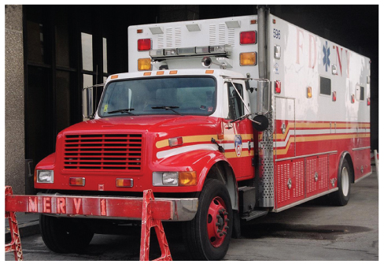
EMS Response Within the
Incident Command System (3 of 5)
FIGURE 40-3 This mobile emergency room is staffed by
EMTs, paramedics, and physicians who are able to provide advanced life support to multiple patients simultaneously on the scene of a mass-casualty incident.
© Jones & Bartlett Learning. Courtesy of MIEMSS.
Notes:
The figure on this slide shows a mobile emergency room.

Slide 24
EMS Response Within the
Incident Command System (4 of 5)
Establishing command
  Command should be established by the most senior official.
  Notification to other responders should go out.
  Necessary resources should be requested.
  Command must be established early.
Notes:
Lecture Outline
C. Establishing command
1. Command should be established by the most senior official, notification to other responders should go out, and necessary resources should be requested.
2. A command system ensures that resources are effectively and efficiently coordinated.
3. Command must be established early, preferably by the first-arriving, most experienced public safety official.

Slide 25
EMS Response Within the
Incident Command System (5 of 5)
Communications
  If possible, use face-to-face communications to limit radio traffic.
  If you communicate via radio, do not use 10-codes or signals.
  Equipment must be reliable, durable, and field-tested.
  Be sure there are backups in place.
Notes:
Lecture Outline
D. Communications
1. If possible, use face-to-face communications to limit radio traffic.
a. If you communicate via radio, do not use 10-codes or signals.
2. Most communications problems should be worked out before a disaster happens by designating channels strictly for command during a disaster.
3. Communications equipment must be reliable, durable, and field-tested.
4. Be sure there are backups in place.

Slide 26
The Medical Branch of Incident Command (1 of 10)
Medical incident command is also known as the medical (or EMS) branch of the ICS.
  Primary roles of triage, treatment, and transport of injured people
Notes:
Lecture Outline
V. The Medical Branch of Incident Command
A. Medical incident command is more commonly known as the medical (or EMS) branch of the ICS.
1. The medical branch director will supervise the primary roles of the medical branch—triage, treatment, and transport of injured people.
2. The medical branch director will help ensure that:
a. EMS units responding to the scene are working within the ICS
b. Each medical division or group receives a clear assignment before beginning work at the scene
c. Personnel remain with their vehicle in the staging area until they are assigned their duties

Slide 27
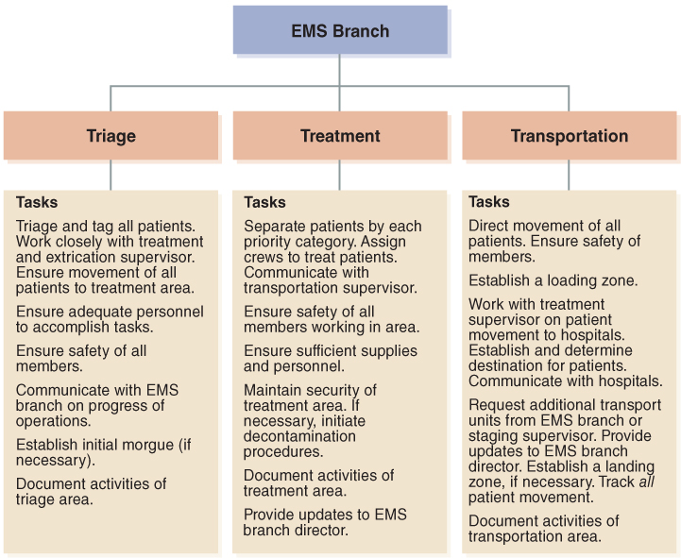
The Medical Branch of Incident Command (2 of 10)
FIGURE 40-4 Components of the medical branch within the incident command system.
© Jones & Bartlett Learning.
Notes:
The figure on this slide illustrates the components of the medical branch.

Slide 28
The Medical Branch of Incident Command (3 of 10)
Triage supervisor
  In charge of counting and prioritizing patients
  Ensures that every patient receives initial assessment of his or her condition
  Do not begin treatment until all patients are triaged.
Notes:
Lecture Outline
B. Triage supervisor
1. Ultimately in charge of counting and prioritizing patients
2. Ensures that every patient receives initial assessment of his or her condition.
3. One of the most difficult parts of being a triage supervisor is that you must not begin treatment until all patients are triaged, or you will compromise your triage efforts.

Slide 29
The Medical Branch of Incident Command (4 of 10)
Treatment supervisor
  Locates and sets up the treatment area with a tier for each priority of patient
  Ensures that secondary triage is performed and that adequate patient care is given
  Assists with moving patients to the transportation area
Notes:
Lecture Outline
C. Treatment supervisor
1. Will locate and set up the treatment area with a tier for each priority of patient.
2. Ensures that secondary triage of patients is performed and that adequate patient care is given as resources allow.
3. Assists with moving patients to the transportation area.

Slide 30
The Medical Branch of Incident Command (5 of 10)
Transportation supervisor
  Coordinates the transportation and distribution of patients to appropriate receiving hospitals
  Documents and tracks the number of transport vehicles, patients transported, and the facility destination
Notes:
Lecture Outline
D. Transportation supervisor
1. Coordinates the transportation and distribution of patients to appropriate receiving hospitals and helps to ensure that hospitals do not become overwhelmed by a patient surge.
2. Documents and tracks the number of transport vehicles, patients transported, and the facility destination of each vehicle and patient.

Slide 31
The Medical Branch of Incident Command (6 of 10)
Staging supervisor
  Should be assigned when scenes require a multivehicle or multiagency response
  Emergency vehicles must have permission to enter the scene and only drive in the directed area.
  The staging area should be established away from the scene.
Notes:
Lecture Outline
E. Staging supervisor
1. A staging supervisor is assigned when an MCI or disaster requires a multivehicle or multiagency response.
2. Emergency vehicles must have permission from the staging supervisor to enter an MCI scene and should only drive in the directed area.
3. The staging area should be established away from the scene so that the parked vehicles are not in the way.

Slide 32
The Medical Branch of Incident Command (7 of 10)
Physicians on scene
  Make difficult triage decisions.
  Provide secondary triage decisions in the treatment area.
  Provide on-scene medical direction for EMTs.
  Provide care in the treatment sector as appropriate.
Notes:
Lecture Outline
F. Physicians on scene
1. Make difficult triage decisions.
2. Provide secondary triage decisions in the treatment area, deciding which priority patients are to be transported first.
3. Provide on-scene medical direction for EMTs, and they can provide care in the treatment sector as appropriate.

Slide 33
The Medical Branch of Incident Command (8 of 10)
Rehabilitation supervisor
  Establishes an area that provides protection from the elements and situation
  Rehabilitation is where a responder’s needs for rest, fluids, food, and protection from the elements are met.
  Monitors responders for signs of stress
Notes:
Lecture Outline
G. Rehabilitation supervisor
1. Establishes an area that provides protection for responders from the elements and the situation.
2. The rehabilitation area should be located away from exhaust fumes and crowds and out of view of the scene itself.
3. Rehabilitation is where a responder’s needs for rest, fluids, food, and protection from the elements are met.
4. Monitors responders for signs of stress.

Slide 34
The Medical Branch of Incident Command (9 of 10)
Extrication and special rescue
  Determines the type of equipment and resources needed for the situation
  Usually function under the EMS branch of the ICS
Notes:
Lecture Outline
H. Extrication and special rescue
1. Determines the type of equipment and resources needed for the situation.

Slide 35
The Medical Branch of Incident Command (10 of 10)
Morgue supervisor
  Works with area medical examiners, coroners, disaster mortuary assistance teams, and law enforcement agencies to coordinate removal of bodies and body parts
  The morgue area should be out of view of the living patients and other responders.
Notes:
Lecture Outline
I. Morgue supervisor
1. Works with area medical examiners, coroners, disaster mortuary assistance teams, and law enforcement agencies to coordinate removal of the bodies and body parts.
2. The morgue supervisor should attempt to leave the dead victims in the location found, if possible, until a removal and storage plan can be determined.
3. The morgue area should be out of view of the living patients and other responders, and it should be secured from the public.

Slide 36
Mass-Casualty Incidents (1 of 3)
A mass-casualty incident (MCI):
  Involves three or more patients
  Places great demand on the EMS system
  Has the potential to produce multiple casualties
Notes:
Lecture Outline
VI. Mass-Casualty Incidents
A. A MCI is:
1. An emergency situation that involves three or more patients, places great demand on the EMS system and/or has the potential to produce multiple casualties.

Slide 37
Mass-Casualty Incidents (2 of 3)
All systems have different protocols for when to declare an MCI and initiate the ICS.
  You and your team cannot treat and transport all injured patients at the same time.
  Never leave the scene with patients if there are still other patients who are sick or wounded.
Notes:
Lecture Outline
B. All systems have different protocols for when to declare an MCI and initiate the ICS.
1. As the EMT, ask yourself the following questions when considering whether the call is an MCI:
a. How many seriously injured or ill patients can you care for effectively and transport in your ambulance?
b. What happens when you have three patients to deal with?
c. How long will it take for additional help to arrive?
d. What happens if the number of patients exceeds the number of available ambulances?
2. You and your team cannot treat and transport all injured patients at the same time.
a. At an MCI, you will often experience an increased demand for equipment and personnel.
b. You should never leave the scene with patients if there are still other patients present who are sick or wounded.

Slide 38
Mass-Casualty Incidents (3 of 3)
If there are multiple patients and not enough resources to handle them without abandoning victims, you should:
  Declare an MCI.
  Request additional resources.
  Initiate the ICS and triage procedures.
Notes:
Lecture Outline
3. If there are multiple patients and not enough resources to handle them without abandoning victims, you should:
a. Declare an MCI.
b. Request additional resources.
c. Initiate the ICS and triage procedures.

Slide 39
Triage (1 of 9)
“Triage” means “to sort” patients based on the severity of their injuries.
  Assessment is brief and patient condition categories are basic.
  Primary triage is done in the field.
  Secondary triage is done as patients are brought to the treatment area.
Notes:
Lecture Outline
VII. Triage
A. “Triage” simply means “to sort” patients based on the severity of their injuries.
1. The goal of doing the greatest good for the greatest number means that the triage assessment is brief and the patient condition categories are basic.
a. Primary triage is the initial triage done in the field.
b. Secondary triage is done as patients are brought to the treatment area.
2. During primary triage, patients are briefly assessed and then identified in some way, such as by attaching a triage tag or triage tape.
3. After the primary triage, the triage supervisor should communicate the following information to the medical branch director:
a. The total number of patients
b. The number of patients in each of the triage categories
c. Recommendations for extrication and movement of patients to the treatment area
d. Resources needed to complete triage and begin movement of patients
4. When the initial triage has been completed, secondary triage (or retriage) can occur, allowing for the EMT to reassess all remaining patients and to upgrade the triage category, if necessary.

Slide 40
Triage (2 of 9)
Four common categories give the order of treatment and transport.
  Immediate (red)
  Delayed (yellow)
  Minor or minimal (green; hold)
  Expectant (black; likely to die or dead)
Notes:
Lecture Outline
B. Triage categories
1. There are four common triage categories.
a. Immediate (red)
b. Delayed (yellow)
c. Minor or minimal (green; hold)
d. Expectant (black; likely to die or dead)
e. Possible addition of an orange tag.
i. An intermediate category between the red tag and yellow tag
ii. A patient could be more appropriately prioritized for treatment and transport if his or her condition required a specific destination that was not a trauma center.

Slide 41
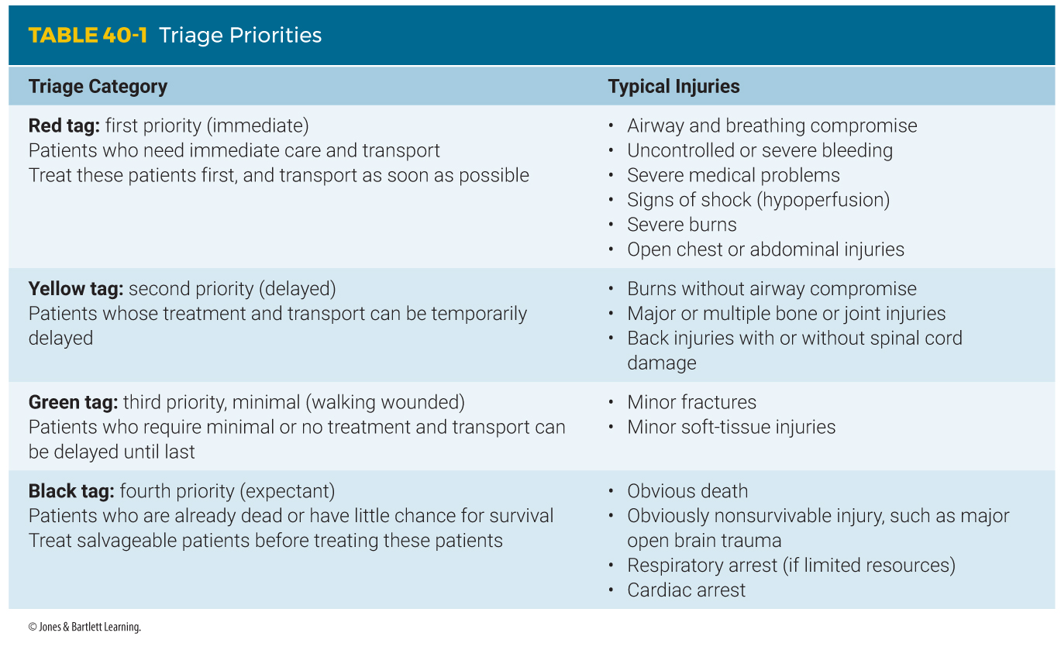
Triage (3 of 9)
Notes:
The table on this slide defines the four common triage categories.

Slide 42
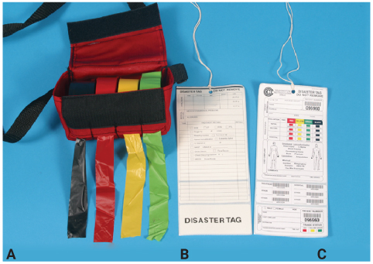
Triage (4 of 9)
Tagging patients early assists in tracking them and can help keep an accurate record of their condition.
  Tags should be weatherproof, easily read, and color-coded.
FIGURE 40-10 Triage tags (from left to right).
A. Waterproof triage tape. B. Triage tag: back.
C. Triage tag: front.
© Jones & Bartlett Learning.
Notes:
Lecture Outline
C. Triage tags
1. Tagging patients early assists in tracking them and can help keep an accurate record of their condition.
2. Triage tags should be weatherproof and easily read.
3. The patient tags or tape should be color-coded and should clearly show the category of the patient.
4. The tags will become part of the patient’s medical record.
5. Whatever labeling system is used, it is imperative for the transportation officer to be able to identify which patient was transported by which unit and to which destination, and the priority of the patient’s condition.

Slide 43
Triage (5 of 9)
START triage
  Simple Triage And Rapid Treatment
  First step is to call out to patients and direct them to an easily identifiable landmark.
    Injured persons are the walking wounded.
  Second step is directed toward nonwalking patients.
    Assess respiratory rate, hemodynamic status, and neurologic status.
Notes:
Lecture Outline
D. START triage
1. One of the easiest methods of triage
a. Stands for Simple Triage And Rapid Treatment
b. Uses a limited assessment of the patient’s ability to walk, respiratory status, hemodynamic status (pulse), and neurologic status
2. The first step is performed on arrival at the scene by calling out to patients at the disaster site and then directing them to an easily identifiable landmark.
a. The injured persons in this group are the walking wounded and are considered minimal (green) priority, or third-priority, patients.
3. The second step is directed toward nonwalking patients.
a. Move to the first nonambulatory patient and assess the respiratory status.
b. If the patient is not breathing, open the airway by using a simple manual maneuver.
c. A patient who still does not begin to breathe is triaged as expectant (black).
d. If the patient begins to breathe, tag him or her as immediate (red), place the patient in the recovery position, and move on to the next patient.
4. If the patient is breathing, make a quick estimation of the respiratory rate.
a. A patient breathing faster than 30 breaths/min or less than 10 breaths/min is triaged as immediate priority (red).
b. If a patient is breathing from 10 to 29 breaths/min, move to the next step.
5. The next step is to assess the hemodynamic status of the patient by checking for bilateral radial pulses.
a. An absent pulse implies that patient is likely hypotensive; tag him or her as an immediate priority.
6. The final assessment is to assess the patient’s neurologic status by assessing the patient’s ability to follow simple commands.
a. A patient who is unconscious or cannot follow simple commands is an immediate priority.

Slide 44
Triage (6 of 9)
JumpSTART triage for pediatric patients
  Intended for use in children younger than 8 years or who appear to weigh less than 100 lb
  Begin by identifying the walking wounded.
  Several differences within the respiratory status assessment compared with START
  Assess the approximate rate of respirations, hemodynamic status, and neurologic status.
Notes:
Lecture Outline
E. JumpSTART triage for pediatric patients
1. Intended for use in children younger than 8 years or who appear to weigh less than 100 lb
2. Begins by identifying the walking wounded
a. Infants or children not developed enough to walk or follow commands (including children with special needs) should be taken as soon as possible to the treatment sector for immediate secondary triage.
3. There are several differences within the respiratory status assessment compared with that in START.
a. If you find that a pediatric patient is not breathing, immediately check the pulse.
b. If there is no pulse, label the patient as expectant (black).
c. If the patient is not breathing but has a pulse, open the airway with a manual maneuver.
d. If the patient does not begin to breathe, give five rescue breaths and check respirations again.
e. A child who does not begin to breathe should be labeled expectant.
f. The most common cause of cardiac arrest in children is respiratory arrest.
4. The next step is to assess the approximate rate of respirations.
5. The next assessment is the hemodynamic status of the patient.
a. Assess the pulse that you feel the most competent and comfortable checking.
b. If there is an absence of a distal pulse, label the child as an immediate priority and move to the next patient.
6. The final assessment is for neurologic status.
a. A modified AVPU score is used.
b. A child who is unresponsive or responds to pain by posturing or with incomprehensible sounds or is unable to localize pain is tagged as an immediate priority.

Slide 45
Triage (7 of 9)
Triage special considerations
  Patients who are hysterical and disruptive to rescue efforts may need to be handled as an immediate priority.
  A responder who becomes sick or injured during the rescue effort should be handled as an immediate priority.
  Identify patients as contaminated or decontaminated in hazmat incidents.
Notes:
Lecture Outline
F. Triage special considerations
1. Patients who are hysterical and disruptive to rescue efforts may need to be handled as an immediate priority and transported off the site, even if they are not seriously injured.
2. A responder who becomes sick or injured during the rescue effort should be handled as an immediate priority and be transported off the site as soon as possible.
3. Hazardous materials (hazmat) and weapons of mass destruction incidents force the hazmat team to identify patients as contaminated or decontaminated before the regular triage process.

Slide 46
Triage (8 of 9)
Destination decisions
  All patients triaged as immediate (red) or delayed (yellow) should be transported by ground or air ambulance.
  In large situations, a bus may transport the walking wounded.
  Immediate-priority patients should be transported two at a time until all are transported from the site.
Notes:
Lecture Outline
G. Destination decisions
1. All patients triaged as immediate (red) or delayed (yellow) should preferably be transported by ground ambulance or air ambulance, if available.
2. In extremely large situations, a bus may transport the walking wounded.
3. Immediate-priority patients should be transported two at a time until all are transported from the site.

Slide 47
Triage (9 of 9)
Destination decisions (cont’d)
  Then patients in the delayed category can be transported two or three at a time.
  Finally, the slightly injured are transported.
  Expectant patients who are still alive would receive treatment and transport last.
  Dead victims are handled or transported according to the SOP for the area.
Notes:
Lecture Outline
a. Then patients in the delayed category can be transported two or three at a time until all are at a hospital.
b. Finally, the walking wounded are transported.
c. Expectant patients who are still alive would receive treatment and transport at this time.
d. Dead victims are handled or transported according to the standard operating procedure for the area.
4. Early notification to receiving facilities will allow for the hospitals to increase staffing and move patients within their facility as required.

Slide 48
Disaster Management (1 of 2)
A disaster is a widespread event.
  Disrupts the functions and resources of the community
  Threatens lives and properties
Many disasters may not involve personal injuries, but many disasters (floods, fires, hurricanes) result in widespread injuries.
Notes:
Lecture Outline
VIII. Disaster Management
A. A disaster is a widespread event that disrupts functions and resources of a community and threatens lives and property.
1. Many disasters may not involve personal injuries.
2. On the other hand, many disasters such as floods, fires, and hurricanes will result in widespread injuries.
a. Unlike an MCI, which generally lasts no longer than a few hours, emergency responders will generally be on the scene of a disaster for days to weeks and sometimes months.
b. Only an elected official can declare a disaster.

Slide 49
Disaster Management (2 of 2)
Your role is to respond when requested and report to the IC for assigned tasks.
  A casualty collection area may be established in a disaster with an overwhelming number of casualties.
  Coordinated through the ICS in the same way as all other branches and areas of the operation
Notes:
Lecture Outline
B. Your role in a disaster is to respond when requested and to report to the IC for assigned tasks.
1. In a disaster with an overwhelming number of casualties, area hospitals may decide that they cannot treat all patients in their facility.
2. They may mobilize medical and nursing teams with equipment.
3. Using a facility such as a warehouse near the disaster scene, they will set up a casualty collection area to:
a. Perform triage
b. Provide medical care
c. Transport patients to the hospital on a priority basis
4. If a casualty collection area is established, it will be coordinated through the ICS in the same way as all other branches and areas of the operation.

Slide 50
Introduction to Hazardous Materials (1 of 3)
When you arrive at a possible hazmat incident, first step back and assess the situation.
Rushing into unsafe scenes can be catastrophic.
  If overcome, you will be unable to assist patients.
Notes:
Lecture Outline
IX. Introduction to Hazardous Materials
A. When you arrive at a possible hazmat incident, you must first step back and assess the situation.
1. Rushing into such unsafe scenes can have catastrophic results.
a. If overcome, you will be unable to assist patients.

Slide 51
Introduction to Hazardous Materials (2 of 3)
According the HAZWOPER, first responders at the awareness level should have sufficient training or experience to demonstrate the following competencies:
  An understanding of what hazardous substances are and the risks associated with them
  An understanding of the potential outcomes of an incident
Notes:
Lecture Outline
B. Because of the unique aspects of responding to and working at a hazmat incident, OSHA has published a set of guidelines known as Hazardous Waste Operations and Emergency Response (HAZWOPER) standard.
1. EMTs are required to have training at the First Responder Awareness Level.
2. First responders at the awareness level should have sufficient training or experience to demonstrate the following competencies:
a. An understanding of what hazardous substances are and the risks associated with them
b. An understanding of the potential outcomes of an incident

Slide 52
Introduction to Hazardous Materials (3 of 3)
Areas of training or experience (cont’d):
  The ability to recognize the presence of hazardous substances
  The ability to identify the hazardous substances, if possible
  An understanding of the role of the first responder awareness individual
  The ability to determine the need for additional resources and to notify the communication center
Notes:
Lecture Outline
c. The ability to recognize the presence of hazardous substances
d. The ability to identify the hazardous substances, if possible
e. An understanding of the role of the first responder awareness individual in the emergency response plan
f. The ability to determine the need for additional resources and to notify the communication center

Slide 53
Recognizing a Hazardous Material (1 of 6)
A hazardous material poses an unreasonable risk of damage or injury if it is not properly controlled during handling, storage, manufacture, processing, packing, use and disposal, and transportation.
Take time to look at the whole scene.
Identify critical visual indicators.
Notes:
Lecture Outline
X. Recognizing a Hazardous Material
A. A hazardous material is any material that poses an unreasonable risk of damage or injury to persons, property, or the environment if it is not properly controlled during:
1. Handling
2. Storage
3. Manufacture
4. Processing
5. Packing
6. Use and disposal
7. Transportation
B. Train yourself to take the time to look at the whole scene so that you can identify the critical visual indicators and fit them into what is known about the problem.

Slide 54
Recognizing a Hazardous Material (2 of 6)
Hazardous materials may be involved in any of the following situations:
  Truck or train crash in which a substance is leaking from a tank truck or tank car
  Leak, fire, or other emergency at an industrial plant, refinery, or other complex
  Leak or rupture of an underground natural gas pipe
Notes:
Lecture Outline
C. Hazardous materials may be involved in any of the following situations:
1. Truck or train crash in which a substance is leaking from a tank truck or railroad tank car
2. Leak, fire, or other emergency at an industrial plant, refinery, or other complex where chemicals or explosives are produced, used, or stored
3. Leak or rupture of an underground natural gas pipe

Slide 55
Recognizing a Hazardous Material (3 of 6)
Hazardous materials may be involved in (cont’d):
  Deterioration of underground fuel tanks and seepage of oil or gasoline into the ground
  Buildup of methane or other by-products of waste decomposition in sewers
  Motor vehicle crash resulting in a ruptured gas tank
Notes:
Lecture Outline
4. Deterioration of underground fuel tanks and seepage of oil or gasoline into the surrounding ground
5. Buildup of methane or other by-products of waste decomposition in sewers or sewage-processing plants
6. A motor vehicle crash resulting in a ruptured gas tank
D. It is important to approach the scene from a safe location and direction.
1. The traditional rules of staying uphill and upwind are a good place to start.
2. Use binoculars and view the scene from a safe distance.
3. Be sure to question anyone involved in the incident.

Slide 56
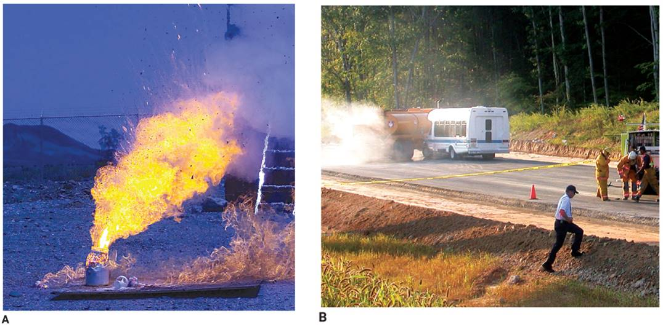
Recognizing a Hazardous Material (4 of 6)
FIGURE 40-12 Two examples of hazardous materials incidents. A. Burning container of flammable liquid. B. Crashed tanker truck.
A: Courtesy of Rob L. Jackson/US Marines; B: Courtesy of George Roarty/Virginia Department of Emergency Management.
Notes:
The figures on this slide show two examples of hazardous materials incidents.

Slide 57
Recognizing a Hazardous Material (5 of 6)
Occupancy and location
  A wide variety of chemicals are stored in locations such as:
    Warehouses
    Hospitals and laboratories
    Industrial complexes
    Residential garages
    Bowling alleys
    Home improvement and garden centers
    Restaurants
Notes:
Lecture Outline
E. Occupancy and location
1. A wide variety of chemicals are stored in a wide range of occupancies and locations.
2. The location and type of building are two good indicators of the possible presence of a hazardous material.

Slide 58
Recognizing a Hazardous Material (6 of 6)
Senses
  The senses that can be safely used are those of sight and sound.
  Using any of your senses that bring you in proximity to the chemical should be done with caution or avoided.
  Clues that are seen or heard from a distance may enable you to take precautionary steps.
Notes:
Lecture Outline
F. Senses
1. The senses that can be safely used are those of sight and sound.
2. Using any of your senses that bring you in proximity to the chemical should be done with caution or avoided.
3. Clues that are seen or heard from a distance may enable you to take precautionary steps.

Slide 59
Containers (1 of 11)
A container is any vessel or receptacle that holds a material.
Often the container type, size, and material of construction provide important clues about the nature of the substance inside.
Two categories: bulk and nonbulk
Notes:
Lecture Outline
G. Containers
1. A container is any vessel or receptacle that holds a material.
2. Often the container type, size, and material of construction provide important clues about the nature of the substance inside.
a. Do not rely solely on the type of container when making a determination about hazardous materials.
3. One way to distinguish containers is to divide them into two categories based on their capacity: bulk and nonbulk storage containers.

Slide 60
Containers (2 of 11)
Container volume
  Bulk storage containers are found in buildings that rely on and need to store large quantities of a particular chemical.
  These containers are often surrounded by a secondary containment system to help control an accidental release.
  Large-volume horizontal tanks are also common.
Notes:
Lecture Outline
4. Container volume
a. Bulk storage containers include:
i. Fixed tanks
ii. Highway cargo tanks
iii. Rail tank cars
iv. Totes
v. Intermodal tanks
b. In general, bulk storage containers are found in buildings that rely on and need to store large quantities of a particular chemical.
c. Often these bulk storage containers are surrounded by a secondary containment system to help control an accidental release.
i. Secondary containment is an engineered method to control spilled or released product if the main containment vessel fails.
d. Large-volume horizontal tanks are also common.

Slide 61
Containers (3 of 11)
Container volume (cont’d)
  Totes have capacities ranging from 119 gallons to 703 gallons.
  Contain any type of chemical, including flammable liquids, corrosives, food-grade liquids, or oxidizers
  No secondary containment system
Notes:
Lecture Outline
e. Totes have capacities ranging from 119 gallons to 703 gallons.
i. They can contain any type of chemical, including flammable liquids, corrosives, food-grade liquids, or oxidizers.
ii. Shipping and storing totes can be hazardous because they have no secondary containment system.

Slide 62
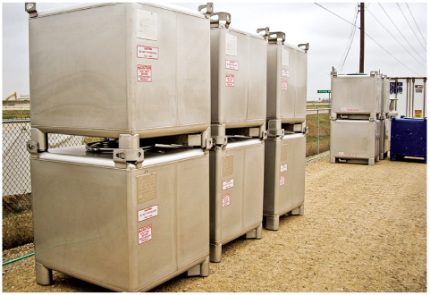
Containers (4 of 11)
FIGURE 40-15 A tote is a commonly encountered bulk
storage vessel.
Courtesy of Tank Service, Inc.
Notes:
The figure on this slide shows totes.

Slide 63
Containers (5 of 11)
Container volume (cont’d)
  Intermodal tanks are both shipping and storage vessels.
  Hold between 5,000 and 6,000 gallons
  Can be pressurized or nonpressurized
Notes:
Lecture Outline
f. Intermodal tanks are both shipping and storage vessels.
i. Hold between 5,000 and 6,000 gallons of product
ii. Can be pressurized or nonpressurized

Slide 64
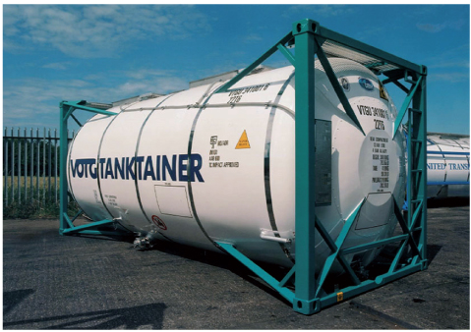
Containers (6 of 11)
FIGURE 40-16 An intermodal tank.
Courtesy of UBH International Ltd.
Notes:
The figure on this slide shows an intermodal tank.

Slide 65
Containers (7 of 11)
Nonbulk storage vessels
  Hold commonly used commercial and industrial chemicals
  Drums are easily recognizable, barrel-like containers.
  Generally, the nature of the chemical dictates the construction of the drum.
Notes:
Lecture Outline
5. Nonbulk storage vessels
a. All types of containers other than bulk containers
b. Hold commonly used commercial and industrial chemicals such as solvents, industrial cleaners, and compounds
c. Drums are easily recognizable, barrel-like containers

Slide 66
Containers (8 of 11)
Nonbulk storage vessels (cont’d)
  Bags are commonly used to store solids and powders.
  May be constructed of plastic, paper, or plastic-lined paper
  Pesticide bags must be labeled with specific information.
Notes:
Lecture Outline
d. Bags are commonly used to store solids and powders
i. Pesticide bags must be labeled with specific information:

Slide 67
Containers (9 of 11)
Nonbulk storage vessels (cont’d)
  Carboys transport and store corrosives and other types of chemicals.
    Glass, plastic, or steel container that holds 5 to 15 gallons of product
    Often placed in a protective wood, foam, fiberglass, or steel box
Notes:
Lecture Outline
e. Carboys are used to transport and store corrosives and other types of chemicals

Slide 68
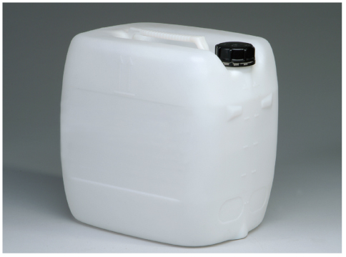
Containers (10 of 11)
FIGURE 40-18 A carboy is used to transport and store
corrosive chemicals.
Courtesy of EMD Chemicals, Inc.
Notes:
The figure on this slide shows a carboy.

Slide 69
Containers (11 of 11)
Nonbulk storage vessels (cont’d)
  Uninsulated compressed gas cylinders are used to store substances such as nitrogen, argon, helium, and oxygen.
Notes:
Lecture Outline
f. Uninsulated compressed gas cylinders are used to store substances such as nitrogen, argon, helium, and oxygen.

Slide 70
Department of Transportation Marking System (1 of 4)
Labels, placards, and other markings are used on buildings, packages, boxes, and containers.
Marking systems indicate the presence of a hazardous material from a safe distance and provide clues about the substance.
Notes:
Lecture Outline
H. The Department of Transportation (DOT) marking system
1. Labels, placards, and other markings are used on buildings, packages, boxes, and containers.
2. Marking systems indicate the presence of a hazardous material from a safe distance and provide clues about the substance.

Slide 71
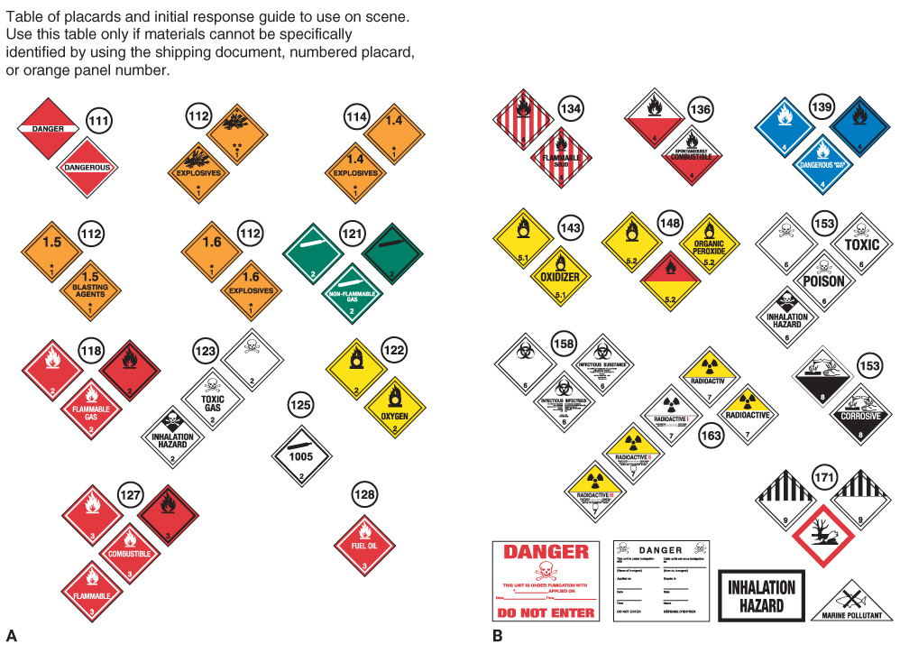
Department of Transportation Marking System (2 of 4)
FIGURE 40-19 The Department of Transportation uses labels, placards, and markings (such as these found in the Emergency Response Guidebook) to give a general idea of the hazard inside a particular container or cargo tank.
Courtesy of the US Department of Transportation.
Notes:
The figure on this slide shows examples of labels, placards, and markings.

Slide 72
Department of Transportation Marking System (3 of 4)
Placards are diamond-shaped indicators.
  Placed on four sides of transport vehicles
Labels are smaller versions of placards.
  Placed on four sides of individual boxes and smaller packages
Notes:
Lecture Outline
a. Placards are diamond-shaped indicators that are placed on all four sides of highway transport vehicles, railroad tank cars, and other forms of transportation carrying hazardous materials.
b. Labels are smaller versions of placards, placed on the four sides of individual boxes and smaller packages being transported.

Slide 73
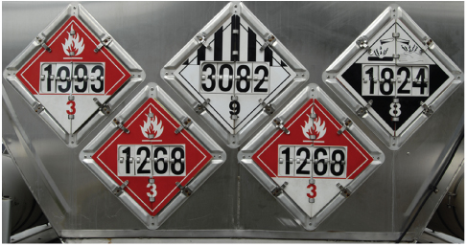
Department of Transportation Marking System (4 of 4)
FIGURE 40-20 A placard is a large diamond-shaped indicator that is placed on all sides of transport vehicles that carry hazardous materials.
© Mark Winfrey/Shutterstock.
Notes:
The figure on this slide displays examples of placards.

Slide 74
Other Considerations
The DOT system does not require that all chemical shipments be marked.
  In most cases, the package or cargo tank must contain a certain amount of hazardous material before a placard is required.
  Some chemicals are so hazardous that shipping any amount requires the use of labels or placards.
Notes:
Lecture Outline
I. Other considerations
1. The DOT system does not require that all chemical shipments be marked with placards or labels.
2. In most cases, the package or cargo tank must contain a certain amount of hazardous material before a placard is required.
a. Commercial package delivery services often carry small amounts of hazardous materials that fall below that weight limit.
b. The vehicle exterior will not display placards to warn of the danger.
3. Some chemicals are so hazardous that shipping any amount of them requires the use of labels or placards, such as:
a. Explosives
b. Poison gases
c. Water-reactive solids
d. High-level radioactive substances

Slide 75
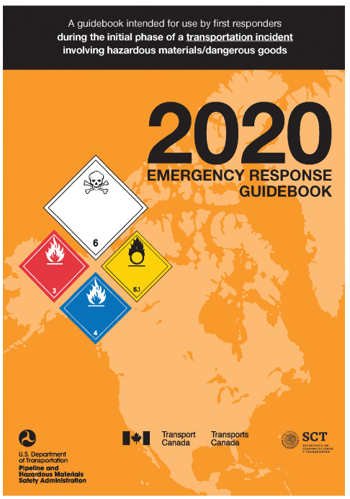
References (1 of 4)
The Emergency Response Guidebook
  Offers a certain amount of guidance for responders operating at a hazmat incident
  Provides information on approximately 4,000 chemicals
FIGURE 40-22 The Emergency Response Guidebook is a reference used as a base for your initial actions at a hazardous materials incident.
Courtesy of the US Department of Transportation.
Notes:
Lecture Outline
J. References
1. The Emergency Response Guidebook
a. Offers a certain amount of guidance for responders operating at a hazmat incident
b. Updated every 3 to 4 years
c. Provides information on approximately 4,000 chemicals

Slide 76
References (2 of 4)
Material safety data sheets (MSDS)
  Common source of information about a particular chemical
  Provides basic information about:
    The chemical makeup of a substance
    The potential hazards it presents
    Appropriate first aid in the event of an exposure
    Other pertinent data for safe handling
Notes:
Lecture Outline
2. Material safety data sheets (MSDS)
a. A common source of information about a particular chemical
b. Provides basic information about:
i. The chemical makeup of a substance
ii. The potential hazards it presents
iii. Appropriate first aid in the event of an exposure
iv. Other pertinent data for safe handling of the material
c. All facilities that use or store chemicals are required by law to have an MSDS on file for each chemical used or stored in the facility.

Slide 77
References (3 of 4)
Shipping papers
  Required whenever materials are transported from one place to another
  Include names and addresses of the shipper and the receiver, identify the material being shipped, and specify the quantity and weight of each part of the shipment
Notes:
Lecture Outline
3. Shipping papers
a. Required whenever materials are transported from one place to another
b. Include the names and addresses of the shipper and the receiver, identify the material being shipped, and specify the quantity and weight of each part of the shipment.
c. Shipping papers for road and highway transportation are called bills of lading or freight bills and are located in the cab of the vehicle.

Slide 78
References (4 of 4)
Chemical Transportation Emergency Center (CHEMTREC)
  CHEMTREC is operated by the American Chemistry Council.
  Serves as an invaluable technical information resource for first responders of all disciplines who are called upon to respond to chemical incidents
Notes:
Lecture Outline
4. Chemical Transportation Emergency Center (CHEMTREC)
a. CHEMTREC is operated by the American Chemistry Council.
b. Provides invaluable technical information for first responders of all disciplines who are called upon to respond to chemical incidents
c. When you call CHEMTREC, be sure to have the following basic information ready:
i. The name of the chemical(s) involved in the incident
ii. Name of the caller and callback telephone number
iii. Location of the actual incident or problem
iv. Shipper or manufacturer of the chemical (if known)
v. Container type
vi. Railcar or vehicle markings or numbers
vii. The shipping carrier’s name
viii. Recipient of material
ix. Local conditions and exact description of the situation

Slide 79
Identification (1 of 2)
Despite the availability of resources, identification may still be difficult.
  Presence of the following may help:
    Visible cloud or strange-looking smoke from the escaping substance
    Leak or spill from a tank, container, truck, or railroad car
    Unusual, strong, noxious, harsh odor in the area
Notes:
Lecture Outline
K. Identification
1. Despite the availability of resources, identification may still be difficult.
a. Little consistency is used on labels and placards, and dishonest transporters sometimes will not label containers or vessels appropriately.
b. Always maintain a high index of suspicion when approaching the scene of a truck or train tanker accident.
2. In the event of a leak or spill, a hazmat incident is often indicated by the presence of the following:
a. Visible cloud or strange-looking smoke from the escaping substance
b. Leak or spill from a tank, container, truck, or railroad car with or without hazmat placards or labels
c. Unusual, strong, noxious (harmful), harsh odor in the area

Slide 80
Identification (2 of 2)
If any signs suggest that a hazmat incident has occurred, stop at a safe distance and park upwind or uphill.
  Call for the hazmat team, try to rapidly assess the situation, and try to provide as much information as possible.
  Do not reenter the scene and do not leave the area until you have been cleared.
  Avoid all contact with the material.
Notes:
Lecture Outline
3. A large number of hazardous gases and fluids are essentially odorless even when a substantial leak or spill has occurred.
a. If you approach a scene where more than one person has collapsed or is unconscious or in respiratory distress, you should assume that there has been a hazmat leak or spill and that it is unsafe to enter the area.
4. The safety of you and your team, the other responders, and the public must be your most important concern.
5. If, as you approach, any signs suggest that a hazmat incident has occurred, you should stop at a safe distance and park upwind or uphill from the incident.
a. After rapidly sizing up the scene, call for the hazmat team.
b. If you do not recognize the danger until you are too close, immediately leave the danger zone.
c. Try to rapidly assess the situation and provide as much information as possible when calling for the hazmat team.
d. Do not reenter the scene and do not leave the area until you have been cleared by the hazmat team.
e. Do not allow civilians to enter the scene, if possible.
f. Avoid all contact with the material.

Slide 81
Hazmat Scene Operations (1 of 6)
Use the ambulance’s public address system.
  Alert individuals near the scene and direct them to move.
Establish control zones.
  Securing access helps ensure that no one will accidentally enter the contaminated area.
Notes:
Lecture Outline
L. Hazmat scene operations
1. Focus your efforts on activities that will ensure the safety and survival of the greatest number of people.
2. Use the ambulance’s public address system to alert individuals near the scene and direct them to move to a safer area.
3. Establishing control zones
a. Control zones are established at a hazmat incident based on the:
i. Chemical and physical properties of the released material
ii. Environmental factors at the time of the release
iii. General layout of the scene
b. Securing access to the incident helps ensure that no one will accidentally enter a contaminated area.
c. If the incident takes place inside a structure, the best place to control access is at the normal points of ingress and egress—doors.
d. If the incident occurs outside, control intersections, on and off ramps, service roads, and other access routes to the scene.

Slide 82
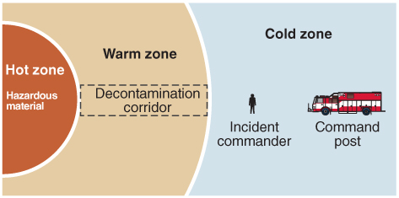
Hazmat Scene Operations (2 of 6)
Establish control zones (cont’d)
  You should be prepared to expand or contract the control zones if necessary.
FIGURE 40-25 Control zones spread outward from the center of a hazardous materials incident.
© Jones & Bartlett Learning.
Notes:
Lecture Outline
e. Control zones may be expanded or contracted as needed.

Slide 83
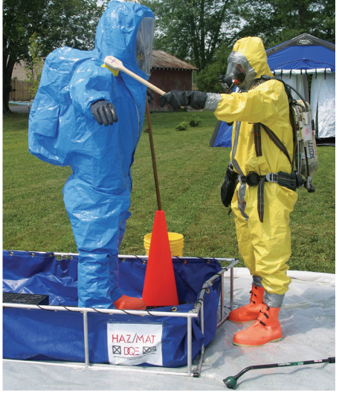
Hazmat Scene Operations (3 of 6)
Hot zone
  Area immediately surrounding the release
  Most contaminated area
  All personnel must be decontaminated when they leave the hot zone.
FIGURE 40-27 The decontamination zone is where firefighters’ and hazmat team members’ outer protective gear is rinsed and washed before removal.
Courtesy of Airman 1st Class Scherrie Gates/US Air Force.
Notes:
Lecture Outline
f. The hot zone is the area immediately surrounding the release, which is also the most contaminated area.
i. All personnel and equipment must be decontaminated when they leave the hot zone.

Slide 84
Hazmat Scene Operations (4 of 6)
Warm zone
  Where personnel and equipment transition into and out of the hot zone
  Contains control points for access to the hot zone and the decontamination area
  Decontamination is the process of removing or neutralizing and properly disposing of hazardous materials.
Notes:
Lecture Outline
g. The warm zone is where personnel and equipment transition into and out of the hot zone.
i. The decontamination area is set up in the warm zone.

Slide 85
Hazmat Scene Operations (5 of 6)
Cold zone
  Safe area where personnel do not need to wear any special protective clothing for safe operation
  Includes personnel staging, the command post, EMS providers, and the area for medical monitoring, support, and/or treatment after decontamination
Notes:
Lecture Outline
h. The cold zone is a safe area where personnel do not need to wear any special protective clothing for safe operation.
i. Personnel staging, the command post, EMS providers, and the area for medical monitoring, support, and/or treatment after decontamination are all located in the cold zone.

Slide 86
Hazmat Scene Operations (6 of 6)
Role of the EMT
  Your job is to report to a designated area outside of the hot and warm zones and provide:
    Triage
    Treatment
    Transport
    Rehabilitation
Notes:
Lecture Outline
4. Role of the EMT
a. Your job is to report to a designated area outside of the hot and warm zones and provide:
i. Triage
ii. Treatment
iii. Transport
iv. Rehabilitation

Slide 87
Classification of Hazardous Materials (1 of 3)
NFPA 704, Hazardous Materials Classification standard classifies hazardous materials according to:
  Health hazard or toxicity levels
  Fire hazard
  Chemical reactive hazard
  Special hazards
Notes:
Lecture Outline
M. Classification of hazardous materials
1. The National Fire Protection Association (NFPA) 704, Hazardous Materials Classification standard classifies hazardous materials according to:
a. Health hazard or toxicity levels
b. Fire hazard
c. Chemical reactive hazard
d. Special hazards

Slide 88
Classification of Hazardous Materials (2 of 3)
Toxicity levels
  Measures the health risk that a substance poses to someone who comes into contact with it
  The higher the number, the greater the toxicity.
Notes:
Lecture Outline
2. Toxicity levels
a. Measures the health risk that a substance poses to someone who comes into contact with it
b. The higher the number, the greater the toxicity, as follows:
i. Level 0 includes materials that would cause little, if any, health hazard if you came into contact with them.
ii. Level 1 includes materials that would cause irritation on contact but only mild residual injury, even without treatment.
iii. Level 2 includes materials that could cause temporary damage or residual injury unless prompt medical treatment is provided.
iv. Level 3 includes materials that are extremely hazardous to health.
v. Level 4 includes materials that are so hazardous that minimal contact will cause death.
c. All health hazard levels, with the exception of 0, require specialized training and respiratory and chemical protective gear that is not standard on most ambulances.

Slide 89
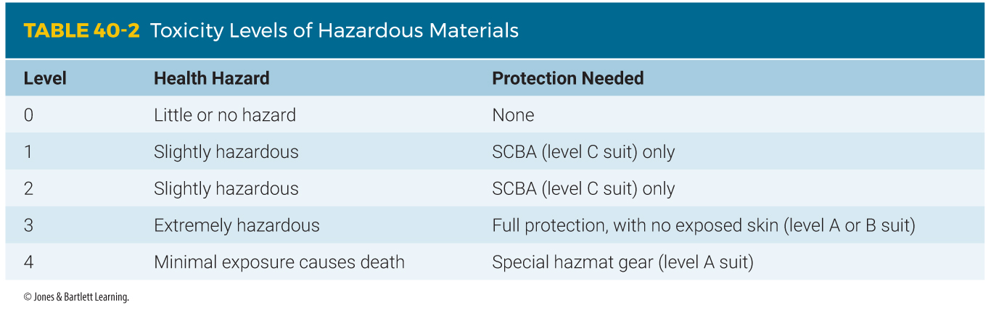
Classification of Hazardous Materials (3 of 3)
Notes:
The table on this slide lists the toxicity levels of hazardous materials.

Slide 90
Personal Protective Equipment Level (1 of 4)
PPE levels indicate the amount and type of protective gear that you need to prevent injury from a substance.
Level A
  Most hazardous
  Requires fully encapsulated, chemical-resistant protective clothing that provides full body protection, as well as SCBA and special, sealed equipment
Notes:
Lecture Outline
N. Personal protective equipment level
1. Personal protective equipment levels indicate the amount and type of protective gear that you need to prevent injury from a particular substance.
2. Level A
a. The most hazardous
b. Requires fully encapsulated, chemical-resistant protective clothing that provides full body protection, as well as SCBA and special, sealed equipment.

Slide 91
Personal Protective Equipment Level (2 of 4)
Level B
  Requires nonencapsulated protective clothing or clothing that is designed to protect against a particular hazard
  Requires breathing devices that contain their own air supply, such as SCBA, and eye protection
Notes:
Lecture Outline
3. Level B
a. Requires nonencapsulated protective clothing or clothing that is designed to protect against a particular hazard
b. Also requires eye protection and breathing devices that contain their own air supply, such as SCBA

Slide 92
Personal Protective Equipment Level (3 of 4)
Level C
  Requires the use of nonpermeable clothing and eye protection
  Face masks that filter all inhaled outside air
Level D
  Requires a work uniform, such as coveralls, that affords minimal protection
All levels require the use of gloves.
Notes:
Lecture Outline
4. Level C
a. Like Level B, requires the use of nonpermeable clothing and eye protection
b. In addition, face masks that filter all inhaled outside air must be used
5. Level D
a. Requires a work uniform, such as coveralls, that affords minimal protection
6. All levels of protection require the use of gloves.
a. Two pairs of rubber gloves are needed for protection in case one pair must be removed because of heavy contamination.

Slide 93
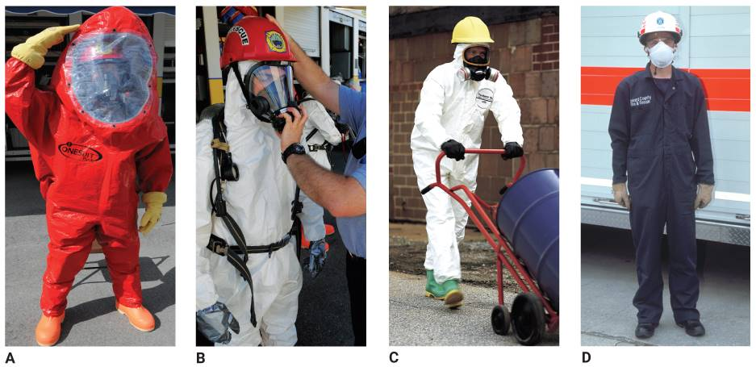
Personal Protective Equipment Level (4 of 4)
FIGURE 40-28 Four levels of protection. A. Level A protection. B. Level B protection. C. Level C protection. D. Level D protection.
A, B: © Jones & Bartlett Learning. Photographed by Glen E. Ellman. C: Courtesy of The DuPont Company.
D: © Jones & Bartlett Learning. Courtesy of MIEMSS.
Notes:
The figures on this slide show the four levels of protection. A. Level A protection. B. Level B protection. C. Level C protection. D. Level D protection.

Slide 94
Caring for Patients (1 of 4)
It is practical only to provide the simplest assessment and essential care in the hazard zone and the decontamination area because of :
  Dangers
  Time constraints
  Bulky protective gear
Notes:
Lecture Outline
O. Caring for patients at a hazmat incident
1. It is practical only to provide the simplest assessment and essential care in the hazard zone and the decontamination area because of:
a. Dangers
b. Time constraints
c. Bulky protective gear that team members wear

Slide 95
Caring for Patients (2 of 4)
Your care of patients must address the following two issues:
  Any trauma that has resulted from other related mechanisms, such as vehicle collision, fire, or explosion
  The injury and harm that have resulted from exposure to the toxic hazardous substance
Notes:
Lecture Outline
2. To avoid entrapment and spread of contaminants, no bandages or splints are applied (except pressure dressings that are needed to control bleeding).
3. The EMTs providing care in the treatment area should assess and treat the patient in the same way as they would a patient who has not been previously assessed or treated.
4. Your care of patients at a hazmat incident must address the following two issues:
a. Any trauma that has resulted from other related mechanisms, such as vehicle collision, fire, or explosion
b. The injury and harm that have resulted from exposure to the toxic hazardous substance

Slide 96
Caring for Patients (3 of 4)
Most serious injuries and deaths from hazardous materials result from airway and breathing problems.
In some cases, the hazmat team may find patients who need immediate treatment before the decontamination area has been set up.
Notes:
Lecture Outline
5. Most serious injuries and deaths from hazardous materials result from airway and breathing problems.
a. If the patient appears to be in distress, give oxygen at 12 to 15 L/min with a nonrebreathing mask.
b. Assist ventilation if needed with a bag-mask device and high-flow oxygen.
6. Treat the patient’s injuries in the same way that you would treat any injury.
7. Your treatment for the patient’s exposure to the toxic substance should focus mainly on supportive care and initiating transport to the hospital.
8. Special care
a. In some cases, before the decontamination area has been completely set up, the hazmat team will find one or two patients who need immediate treatment and transport without further delay if they are to survive.

Slide 97
Caring for Patients (4 of 4)
You will need to increase the amount of protective clothing you wear, including:
  SCBA
  Two pairs of gloves
  Goggles or a face shield
  A protective coat
  Respiratory protection
  A disposable, fluid-impervious apron
Notes:
Lecture Outline
b. It may be necessary to simply cut away all of the patient’s clothing and do a rapid rinse to remove the majority of the contaminating matter before transport.
c. You will need to increase the amount of protective clothing you wear, including:
i. SCBA
ii. Two pairs of gloves
iii. Goggles or a face shield
iv. A protective coat
v. Respiratory protection
vi. A disposable, fluid-impervious apron or similar outfit
d. To make decontaminating the ambulance easier, tape the cabinet doors shut.
i. Any equipment kits, monitors, and other items that will not be used en route should be removed from the patient compartment and placed in the front of the ambulance or in outside compartments.
ii. Before loading the patient, turn on the power vent ceiling fan and patient compartment air-conditioning unit fan.
e. When you leave the scene, inform the hospital that you are transporting a critically injured patient who has not been fully decontaminated at the scene.

Slide 98
Review
What is the purpose of the incident command system (ICS)?
  Ensuring responder and public safety
  Achieving incident management goals
  Ensuring the efficient use of resources
  All of the above

Slide 99
Review
Answer: D
Rationale: The purpose of the ICS is ensuring responder and public safety, achieving incident management goals, and ensuring the efficient use of resources.

Slide 100
Review
What is the purpose of the incident command system (ICS)?
  Ensuring responder and public safety
  Rationale: This is one purpose of the ICS.
  Achieving incident management goals
  Rationale: This is one purpose of the ICS.
  Ensuring the efficient use of resources
  Rationale: This is one purpose of the ICS.
  All of the above
  Rationale: Correct answer

Slide 101
Review
Upon arriving at a scene in which the incident command system has been activated, you should expect to:
  be passed from sector to sector, as needed, in between assignments.
  report directly to the incident commander in between assignments.
  be assigned a specific responsibility for the duration of the incident.
  be given general directions and allowed to function independently.

Slide 102
Review
Answer: A
Rationale: The incident commander establishes sectors of responsibility and sector officers. When functioning at an incident in which the incident command system has been activated, you should report to the appropriate sector officer, carry out your assignment, and report back to the sector officer. In many cases, you will be asked to report to a different sector.

Slide 103
Review
Upon arriving at a scene in which the incident command system has been activated, you should expect to:
  be passed from sector to sector, as needed, in between assignments.
  Rationale: Correct answer
  report directly to the incident commander in between assignments.
  Rationale: Only sector or unit officers report to the IC.
  be assigned a specific responsibility for the duration of the incident.
  Rationale: Responsibilities may change as sector officers see the need for change.
  be given general directions and allowed to function independently.
  Rationale: The purpose behind the ICS is to prevent personnel from freelancing.

Slide 104
Review
When EMS responds to a disaster, as part of their response within the ICS, EMS would start with a scene size-up. What is the next step for the first-responding units?
  Communicating with additional units
  Establishing command
  Caring for any injuries
  Stabilizing the incident

Slide 105
Review
Answer: B
Rationale: The first EMS unit to arrive needs to function within the ICS. Once you have performed a good scene size-up and answered the three basic questions to complete a scene size-up, command should be established by the most senior official, notification to other responders should go out, and necessary resources should be requested.

Slide 106
Review
When EMS responds to a disaster, as part of their response within the ICS, EMS would start with a scene size-up. What is the next step for the first-responding units?
  Communicating with additional units
  Rationale: Communications occur after establishing command.
  Establishing command
  Rationale: Correct answer
  Caring for any injuries
  Rationale: Triage occurs after communications have been established.
  Stabilizing the incident
  Rationale: Demobilization procedures occur at the end of the response.

Slide 107
Review
Which of the following statements BEST describes a mass-casualty incident?
  At least half of the patients are dead.
  Either a bus or an airplane has crashed.
  You have more than two critical patients.
  The patient count exhausts your resources.

Slide 108
Review
Answer: D
Rationale: A mass-casualty situation is one that places such a great demand on available equipment or personnel that the system is stretched to its limits or beyond. While bus accidents and plane crashes are classic examples of MCIs, they are not the only situations that can exhaust your resources.

Slide 109
Review
Which of the following statements BEST describes a mass-casualty incident?
  At least half of the patients are dead.
  Rationale: MCIs are not based upon the number of fatalities.
  Either a bus or an airplane has crashed.
  Rationale: This is a good example of a potential MCI; however, there may be very few patients.
  You have more than two critical patients.
  Rationale: This situation places a burden upon the first EMS providers, but it may not stress available resources.
  The patient count exhausts your resources.
  Rationale: Correct answer

Slide 110
Review
Which of the following patients would have the HIGHEST treatment priority at the scene of a mass-casualty incident?
  24-year-old man who is unconscious, has snoring respirations, and severe burns
  32-year-old woman who is pulseless and apneic with an abdominal evisceration
  29-year-old woman who is in full cardiac arrest with massive open chest trauma
  32-year-old man with an open head injury, exposed brain matter, and no carotid pulse

Slide 111
Review
Answer: A
Rationale: Three of the four patients (B, C, and D) are dead. Triage efforts are aimed at providing the greatest amount of good for the greatest number of people. Attempting to resuscitate a patient in traumatic cardiac arrest is futile in almost all cases.

Slide 112
Review
Which of the following patients would have the HIGHEST treatment priority at the scene of a mass-casualty incident?
  24-year-old man who is unconscious, has snoring respirations, and severe burns
  Rationale: Correct answer
  32-year-old woman who is pulseless and apneic with an abdominal evisceration
  Rationale: The woman has minimal possibilities of survival with no vital signs upon arrival.
  29-year-old woman who is in full cardiac arrest with massive open chest trauma
  Rationale: This patient presents with a low possibility of surviving.
  32-year-old man with an open head injury, exposed brain matter, and no carotid pulse
  Rationale: This patient presents with a low possibility of surviving.

Slide 113
Review
How does a disaster differ from a mass-casualty incident?
  Disasters may not involve personal injuries.
  In a disaster, EMS may be on the scene for days or weeks.
  Only an elected official can declare a disaster.
  All of the above

Slide 114
Review
Answer: D
Rationale: Many disasters, such as droughts that cause widespread crop damage, do not involve personal injury. An MCI generally lasts no longer than a few hours, but emergency responders may be on the scene for days or weeks in a disaster. Although you can “declare” an MCI, only an elected official can declare a disaster.

Slide 115
Review
How does a disaster differ from a mass-casualty incident?
  Disasters may not involve personal injuries.
  Rationale: This is true of a disaster.
  In a disaster, EMS may be on the scene for days or weeks.
  Rationale: This is true of a disaster.
  Only an elected official can declare a disaster.
  Rationale: This is true of a disaster.
  All of the above
  Rationale: Correct answer

Slide 116
Review
A large tanker truck has overturned on a highway. When you arrive, you see a clear liquid leaking from the rear of the tanker. The driver, who appears to be unconscious, is still in the vehicle and is bleeding heavily from the face. You should:
  immediately notify law enforcement for traffic control.
  fully assess the situation and request the appropriate assistance.
  put on gloves, a gown, and a mask and quickly remove the driver.
  go to the rear of the tanker and determine what type of fluid is leaking.

Slide 117
Review
Answer: B
Rationale: Upon arriving at the scene of a possible hazmat incident, you must first step back and assess the situation. This can be very stressful—especially if you see a patient. However, rushing into such a situation puts your own life in jeopardy. Once you have properly assessed the scene, you should request the appropriate assistance, such as the fire department or hazardous materials team.

Slide 118
Review
A large tanker truck has overturned on a highway. When you arrive, you see a clear liquid leaking from the rear of the tanker. The driver, who appears to be unconscious, is still in the vehicle and is bleeding heavily from the face. You should:
  immediately notify law enforcement for traffic control.
  Rationale: Law enforcement is part of the assistance needed at the scene; however, rescue, fire, and hazmat providers must also be notified.
  fully assess the situation and request the appropriate assistance.
  Rationale: Correct answer
  put on gloves, a gown, and a mask and quickly remove the driver.
  Rationale: This is a potentially hazardous environment. Access should not be attempted until the scene has been deemed safe.
  go to the rear of the tanker and determine what type of fluid is leaking.
  Rationale: Unless you are trained as a hazmat technician and are part of the entry team, do not enter the hazard zone.

Slide 119
Review
Which of the following situations MOST likely involves a hazardous material?
  Milk truck that overturned and is leaking fluid
  Tractor trailer rig that is emitting a visible cloud
  Moving van that collided head-on with a small car
  Pickup truck from the gas company that struck a tree

Slide 120
Review
Answer: B
Rationale: A crash does not need to occur for a spill or leak to happen. A vehicle that is emitting a visible cloud should make you suspicious that a hazardous material is involved—especially if the vehicle is a tractor trailer rig. In such cases, you should stay uphill and upwind and notify the fire department or hazmat team.

Slide 121
Review
Which of the following situations MOST likely involves a hazardous material?
  Milk truck that overturned and is leaking fluid
  Rationale: This is a possibility, but not the most likely possibility.
  Tractor trailer rig that is emitting a visible cloud
  Rationale: Correct answer
  Moving van that collided head-on with a small car
  Rationale: This is a possibility, but not the most likely possibility.
  Pickup truck from the gas company that struck a tree
  Rationale: This is a possibility, but not the most likely possibility.

Slide 122
Review
When dealing with a hazardous materials incident, where should you set up your decontamination area?
  Inside the hazard zone
  Inside the treatment area
  Between the hazard zone and treatment area
  Between the treatment and transportation zone

Slide 123
Review
Answer: C
Rationale: The decontamination area should be set up between the hazard zone and the treatment area. This way, patients cannot bring any hazardous materials into the treatment area and contaminate anyone else.

Slide 124
Review
When dealing with a hazardous materials incident, where should you set up your decontamination area?
  Inside the hazard zone
  Rationale: It needs to be on the edge of the hazard zone—not inside it.
  Inside the treatment area
  Rationale: You do not want contaminated patients in the treatment area.
  Between the hazard zone and treatment area
  Rationale: Correct answer
  Between the treatment and transportation zone
  Rationale: Patients need to be decontaminated prior to entering the treatment and transport area.

Slide 125
Review
Which toxicity level would you assign a hazardous material spill that could cause a person temporary damage or residual injury unless prompt medical treatment is given?
  Level 1
  Level 2
  Level 3
  Level 4

Slide 126
Review
Answer: B
Rationale: Level 2 toxicity includes materials that could cause temporary damage or residual injury unless prompt medical treatment is provided. Level 1 toxicity includes materials that would cause little, if any, health hazard. Level 3 toxicity includes materials that are extremely hazardous to health and requires full protective gear. Level 4 toxicity includes materials that are so hazardous that even minimal contact will cause death.

Slide 127
Review
Which toxicity level would you assign a hazardous material spill that could cause a person temporary damage or residual injury unless prompt medical treatment is given?
  Level 1
  Rationale: Level 1 materials cause few health hazards.
  Level 2
  Rationale: Correct answer
  Level 3
  Rationale: Level 3 materials are extremely hazardous.
  Level 4
  Rationale: Level 4 materials cause death, even with minimal contact.

